Slide 1

NUS-ISS
Intelligent Sensing and Sense Making
Module 3 - Workshop on sensor signal processing
by Hu Zhengqing
© 2024 National University of Singapore.
All Rights Reserved.

Slide 2
Dynamic Time Warping

Slide 3
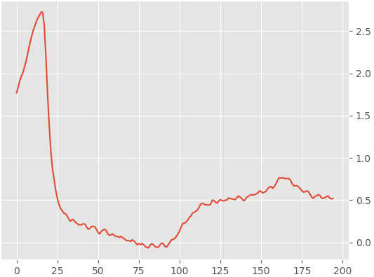
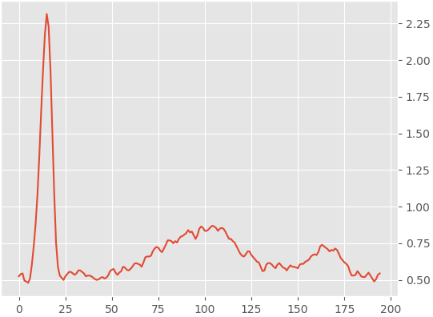
Problem
How similar are these two signals?
In which manners are they similar?
Notes:
Can estimate from naked eye but can quantify it?

Slide 4
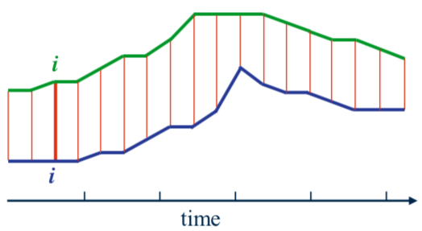
Can we try ...
Euclidean, Manhattan .....?
We can measure the similarity of two signals by calculating the distance between the i-th point on one signal and the i-th point on another signal
Simple concept, but could not capture the similarity in shape
Source: "Dynamic Time Warping Algorithm", by Elena Tsiporkova
Notes:
Ok for shapes with same phase. But what if both shapes are out of phase like here……
We can do adjustment to calculate similarity between two shapes that are out of phase

Slide 5
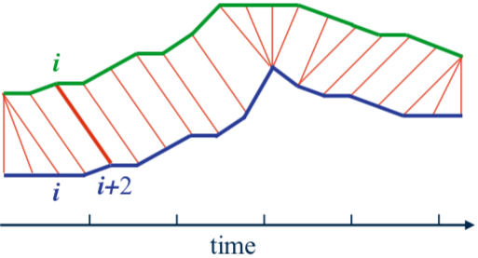
How about ...
non-linear alignment .....?
Elastic alignment between points of two signals produces a better, more intuitive similarity measure
Allow similar shapes to match even if they are out of phase
Source: "Dynamic Time Warping Algorithm", by Elena Tsiporkova
Notes:
shape, morphology

Slide 6

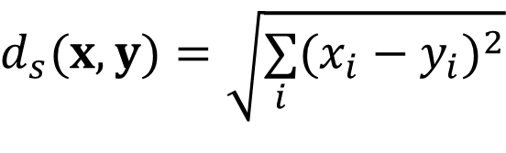


Distance
Another term to say 'similiarity'
Consider two distinct signals
$$x=[x_{1},x_{2},...,x_{i},...x_{m}]$$
$$y=[y_{1},y_{2},...,y_{j},...y_{n}]$$
The distance between the two signals is defined as
$$d_{s}(x,y)$$
Euclidean distance between two signals:
$$d_{s}(x,y)=\sqrt{\underset{i}{∑}(x_{i}−y_{i})^{2}}$$
Problem: two signals must be of same length!
Notes:
Major concern for this method: What if m not equal to n? → unable to use Euclidean distance method

Slide 7
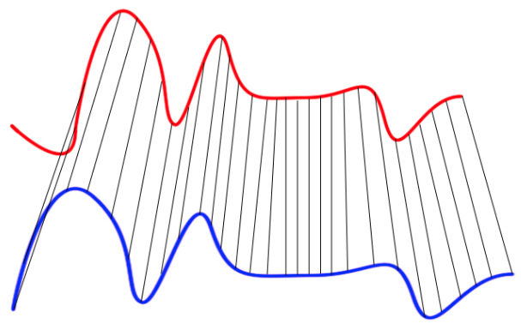
Dynamic Time Warping
DTW
An algorithm to measure similarity between two temporal sequences (signal), which may vary in speed
DTW calculates an optimal match between two given sequences
Sequences are warped along time dimension to determine similarity independent of variations in time
DTW produces warping path, which enables alignment between two signals
Source: https://th.wikipedia.org/wiki/Dynamic_time_warping#/media/File:Euclidean_vs_DTW.jpg

Slide 8
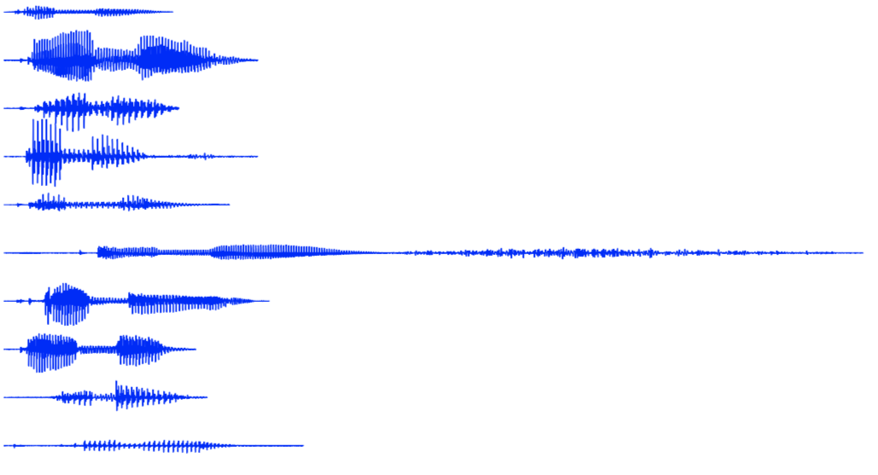
Dynamic Time Warping
Usage
Commonly used in speech recognition
Individual never pronounces one word twice in exact way
People never pronounce one word with the same timing
"timing"
Source: "Speech Recognition - Intro and DTW", by Jan Černocky
Notes:
In this example: many ways to say the word, “timing”
Euclidean distance not possible to account for variations in time as length of signals must be the same!
With DTW, it is possible to account for the variations in time

Slide 9
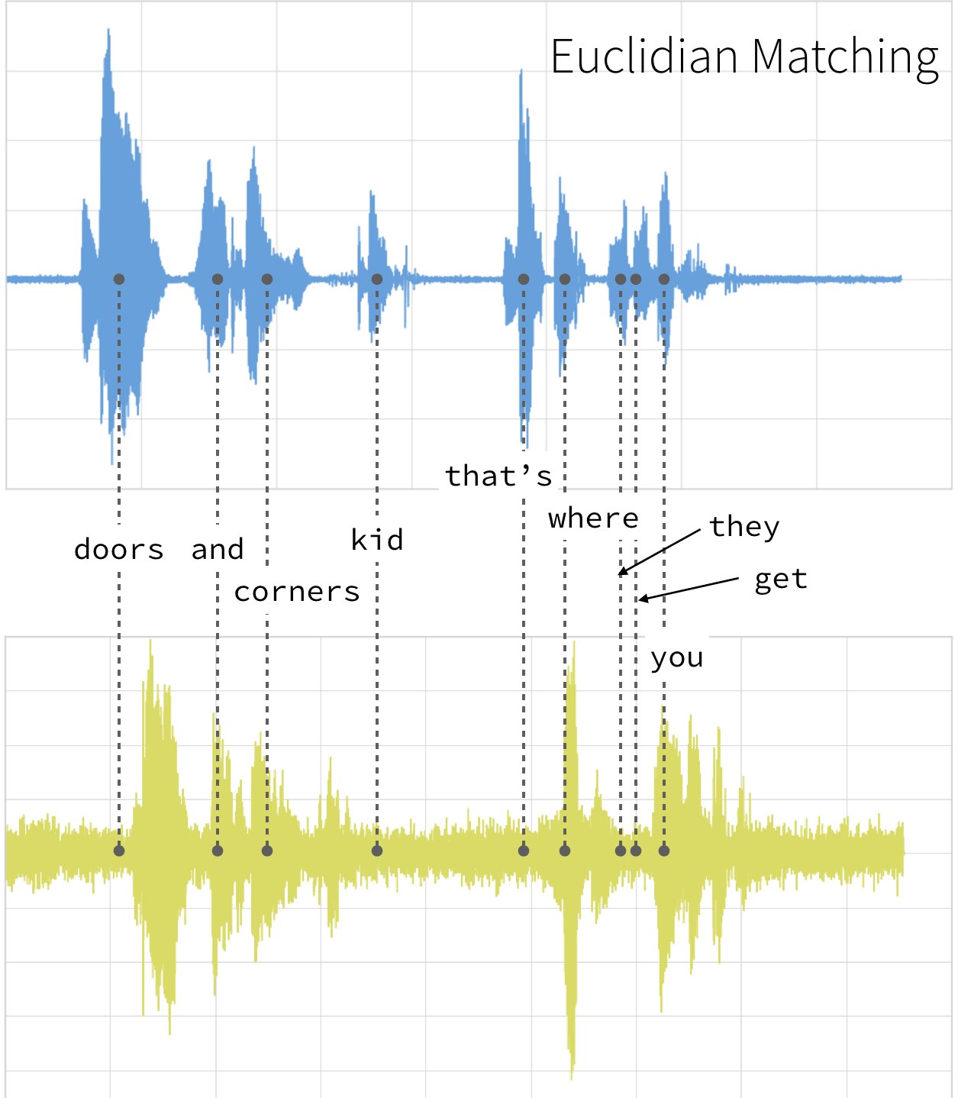
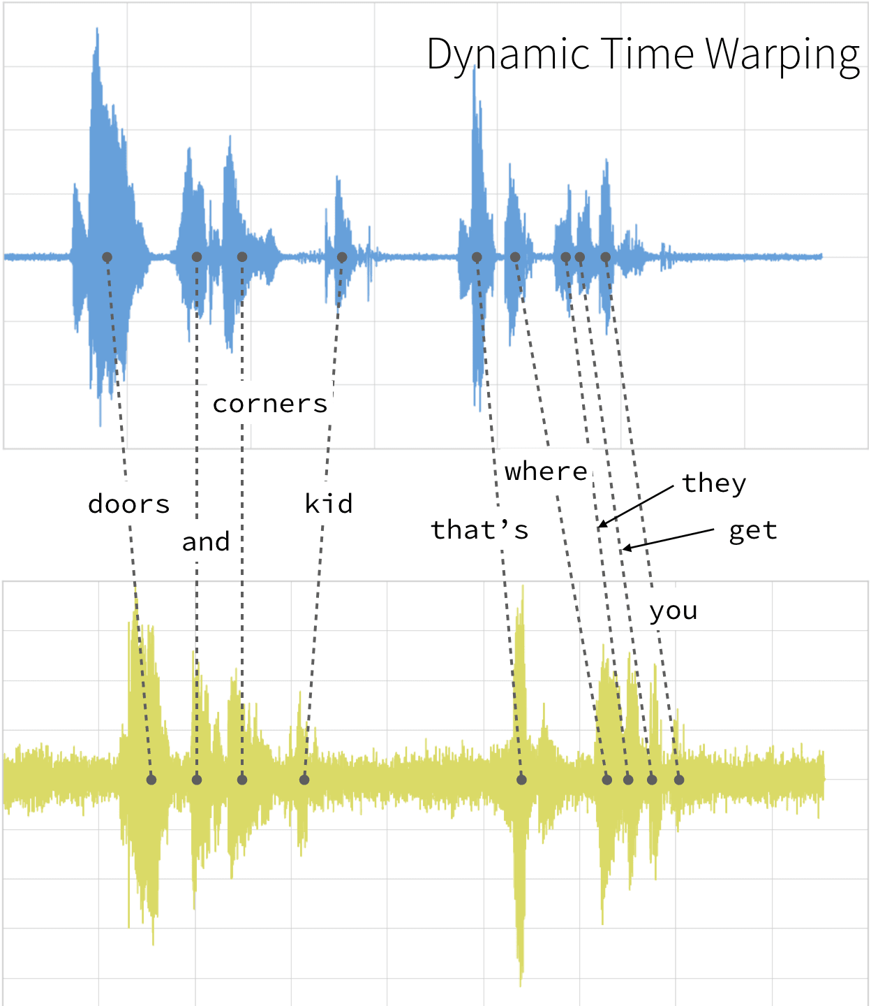
Dynamic Time Warping
Vs Euclidean (Comparison of Audio Clips Example)
Notes:
Using Euclidean distance method will not be an accurate representation (show example)

Slide 10
Dynamic Time Warping
Dynamic signature recognition
Users sign their signature on digital tablet
Dynamic information captured:
x position
y position
pressure
azimuth
inclination
Use DTW to check / match signature
Source: "Speech Recognition - Intro and DTW", by Jan Černocky
Notes:
Another example: Signatures; many ways of signing the same signatures

Slide 11
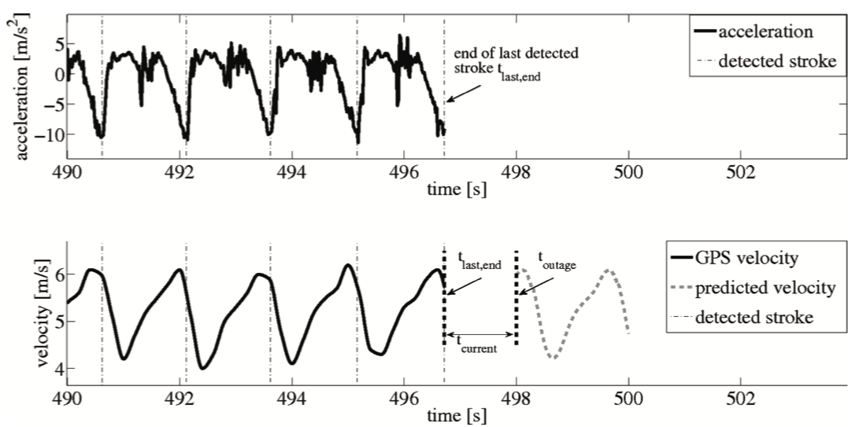
Dynamic Time Warping
Stroke detection (rowing)
Use DTW to detect stroke (used in rowing competitions)
With strokes detected, predict boat's movement and position when sensor transmission lost
Source: "Movement prediction in rowing using a dynamic time warping base stroke detection", by Groh et al.
Notes:
Can even integrate DTW method in Deep Learning Model for prediction purposes

Slide 12
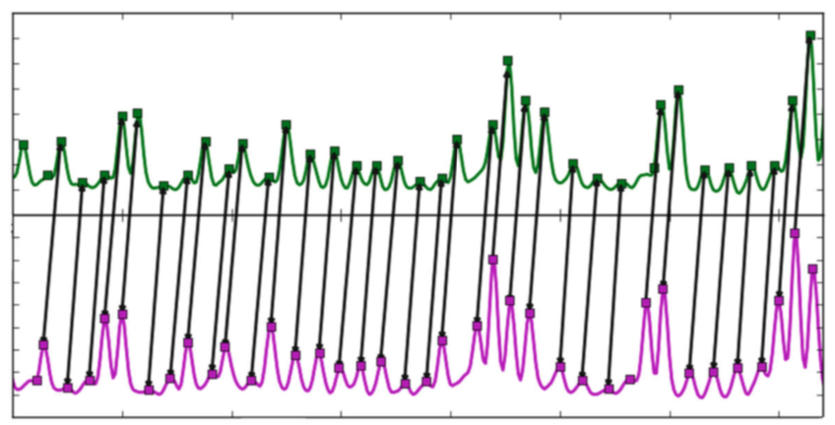
Dynamic Time Warping
Peak alignment in DNA sequencing
Use DTW to align peaks in electropherogram (a plot generated by DNA sequencer)
Accurate alignment gives better interpretation (e.g. better RNA secondary structure prediction)
with reagent
without reagent
Source: "A peak alignment algorithm with novel improvements in application to electropherogram analysis", by Karabiber
Notes:
Using Euclidean distance method will not be an accurate representation (show example)

Slide 13
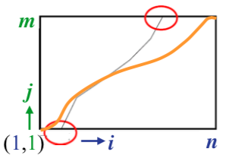
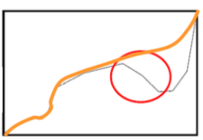
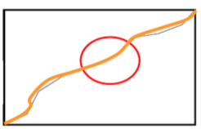


Dynamic Time Warping
Overview of algorithm
row
clm
Start by constructing n x m matrix D, in which
n x m matrix covers the window boundaries
orange curve = correct wrapping path
$$D_{i,j}=d_{s}(y_{i},x_{j})$$
where
$$d_{s}(y_{i},x_{j})=(y_{i}−x_{j})^{2}$$
Create a warping path w that maps points between x and y, the path w must satisfy the following rules:
Boundary conditions
Monotonicity
Continuity
j
i
Source: "Dynamic time warping algorithm", by Elena Tsiporkova
Notes:
n x m matrix covers the window boundaries → orange curve = correct wrapping path → example of wrong wrapping path (violate rules)
1st Rule: start point from bottom left and end point at top right
2nd Rule: Cannot move back in direction
3rd Rule: cannot have a break in between! Must be continuous

Slide 14
Dynamic Time Warping
Overview of algorithm
row
clm
Start by constructing n x m matrix D, in which
1st Rule: start point from bottom left and end point at top right
2nd Rule: Cannot move back in direction
3rd Rule: cannot have a break in between! Must be continuous
$$D_{i,j}=d_{s}(y_{i},x_{j})$$
where
$$d_{s}(y_{i},x_{j})=(y_{i}−x_{j})^{2}$$
Create a warping path w that maps points between x and y, the path w must satisfy the following rules:
Boundary conditions
Monotonicity
Continuity
j
i
Source: "Dynamic time warping algorithm", by Elena Tsiporkova
Notes:
n x m matrix covers the window boundaries → orange curve = correct wrapping path → example of wrong wrapping path (violate rules)
1st Rule: start point from bottom left and end point at top right
2nd Rule: Cannot move back in direction
3rd Rule: cannot have a break in between! Must be continuous

Slide 15
Dynamic Time Warping
Overview of algorithm
DTW algorithm consists of mainly 3 parts:
Compute distance matrix
Compute accumulated cost matrix
Search the optimal path
To start the code, import the necessary libraries, and setup a bit
> import numpy as np
> import matplotlib.pyplot as plt
> import pandas as pd
> plt.style.use('ggplot')
> plt.rcParams['ytick.right'] = True
> plt.rcParams['ytick.labelright'] = True
> plt.rcParams['ytick.left'] = False
> plt.rcParams['ytick.labelleft'] = False
Codes to import libraries and to perform some setup
Notes:
codes to import libraries and to perform some setup

Slide 16
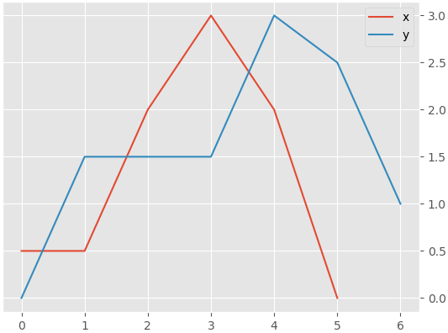
Dynamic Time Warping
1. Compute distance matrix
Define two simple short signals:
> x = np.array([0.5,0.5,2.0,3.0,2.0,0.0])
> y = np.array([0.0,1.5,1.5,1.5,3.0,2.5,1.0])
Plot the two signals
> plt.figure()
> plt.plot(x,
color="C0",
label='x')
> plt.plot(y,
color="C1",
label='y')
> plt.legend()
Notes:
x is red line and y is blue line; codes to plot the charts

Slide 17


Dynamic Time Warping
1. Compute distance matrix
Compute the distance matrix is straightforward, since the matrix is defined as
applying maths formula to calculate the distance matrix in DTW
$$D_{i,j}=d_{s}(y_{i},x_{j})$$
and
$$d_{s}(y_{i},x_{j})=(y_{i}−x_{j})^{2}$$
The corresponding code
dists
> dists = np.zeros((len(y),len(x)))
> for i in range(len(y)):
for j in range(len(x)):
dists[i,j] = (y[i]-x[j])**2
[[0.25, 0.25, 4. , 9. , 4. , 0. ],
[1. , 1. , 0.25, 2.25, 0.25, 2.25],
[1. , 1. , 0.25, 2.25, 0.25, 2.25],
[1. , 1. , 0.25, 2.25, 0.25, 2.25],
[6.25, 6.25, 1. , 0. , 1. , 9. ],
[4. , 4. , 0.25, 0.25, 0.25, 6.25],
[0.25, 0.25, 1. , 4. , 1. , 1. ]]
Notes:
applying maths formula to calculate the distance matrix in DTW → codes that represent this formula
Ask students to take note that output from these codes turn out to be inverted
From example, show that the top left cell represented by D[0,0] due to the inversion! Desired position of this cell should be bottom left instead!
While on its right, the cell is represented by D[0,1]

Slide 18
Dynamic Time Warping
1. Compute distance matrix
Compute the distance matrix is straightforward, since the matrix is defined as
Note: Output from these codes is inverted
i.e. top left cell = D[0,0]; bottom left should be D[0,0] instead
$$D_{i,j}=d_{s}(y_{i},x_{j})$$
and
$$d_{s}(y_{i},x_{j})=(y_{i}−x_{j})^{2}$$
The corresponding code
dists
> dists = np.zeros((len(y),len(x)))
> for i in range(len(y)):
for j in range(len(x)):
dists[i,j] = (y[i]-x[j])**2
[[0.25, 0.25, 4. , 9. , 4. , 0. ],
[1. , 1. , 0.25, 2.25, 0.25, 2.25],
[1. , 1. , 0.25, 2.25, 0.25, 2.25],
[1. , 1. , 0.25, 2.25, 0.25, 2.25],
[6.25, 6.25, 1. , 0. , 1. , 9. ],
[4. , 4. , 0.25, 0.25, 0.25, 6.25],
[0.25, 0.25, 1. , 4. , 1. , 1. ]]
Notes:
applying maths formula to calculate the distance matrix in DTW → codes that represent this formula
Ask students to take note that output from these codes turn out to be inverted
From example, show that the top left cell represented by D[0,0] due to the inversion! Desired position of this cell should be bottom left instead!
While on its right, the cell is represented by D[0,1]

Slide 19
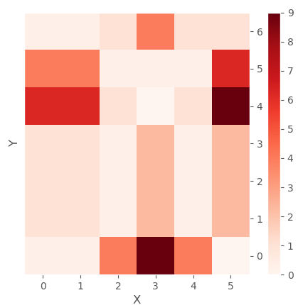
Dynamic Time Warping
1. Compute distance matrix
Create a function to do a plot on the distance matrix
Inverted because viridis starts from top left
> def pltDistances(dists,xlab="X",ylab="Y",clrmap="viridis"):
imgplt = plt.figure()
plt.imshow(dists,
interpolation='nearest',
cmap=clrmap)
plt.gca().invert_yaxis()
plt.xlabel(xlab)
plt.ylabel(ylab)
plt.grid()
plt.colorbar()
return imgplt
> pltDistances(dists,clrmap='Reds')
Notes:
inverted because viridis starts from top left
We need to invert to allow it to start from bot left, which is the correct configuration!
plt.gca().invert_yaxis() → #This is added so that the y axis start from bottom, instead of top

Slide 20
Dynamic Time Warping
1. Compute distance matrix
Do take note, in the plot, the y axis is inverted
Thus, first row of the matrix corresponds to the last row in the figure
[[0.25, 0.25, 4. , 9. , 4. , 0. ],
[1. , 1. , 0.25, 2.25, 0.25, 2.25],
[1. , 1. , 0.25, 2.25, 0.25, 2.25],
[1. , 1. , 0.25, 2.25, 0.25, 2.25],
[6.25, 6.25, 1. , 0. , 1. , 9. ],
[4. , 4. , 0.25, 0.25, 0.25, 6.25],
[0.25, 0.25, 1. , 4. , 1. , 1. ]]
Notes:
plt.gca().invert_yaxis()
# This is added so that the y axis start from bottom, instead of top

Slide 21



Dynamic Time Warping
2. Compute accumulated cost matrix
The accumulated cost matrix is defined
Cost matrix important to determine wrapping path!
$$A_{i,j}=D_{i,j}+min(A_{i−1,j},A_{i,j−1},A_{i−1,j−1})$$
When i and j equals to 0
Ai, j equals to Di, j plus either Ai-1, j-1, Ai, j-1 or Ai-1,j , whichever has the lowest value
$$A_{0,0}=D_{0,0}$$
 | Ai, j-1 | Ai, j
 | Ai-1, j-1 | Ai-1 ,j
When i equals to 0 (first row)
i
$$A_{0,j}=D_{0,j}+A_{0,j−1}$$
When j equals to 0 (first column)
$$A_{i,0}=D_{i,0}+A_{i−1,0}$$
j
Notes:
Cost matrix important to determine wrapping path!
Formulas to calculate accumulated cost of each cell
Show example of when j=0 (first column) → A[1,0], A[2,0], etc

Slide 22











Dynamic Time Warping
2. Compute accumulated cost matrix
When i equals to 0 (first row)
$$A_{0,j}$$
$$=$$
$$D_{0,j}$$
$$+$$
$$A_{0,j−1}$$
When j equals to 0 (first column)
$$A_{i,0}$$
$$=$$
$$D_{i,0}$$
$$+$$
$$A_{i−1,0}$$
j
0.25 | 0.25 | 1 | 4 | 1 | 1
4 | 4 | 0.25 | 0.25 | 0.25 | 6.25
6.25 | 6.25 | 1 | 0 | 1 | 9
1 | 1 | 0.25 | 2.25 | 0.25 | 2.25
1 | 1 | 0.25 | 2.25 | 0.25 | 2.25
1 | 1 | 0.25 | 2.25 | 0.25 | 2.25
0.25 | 0.25 | 4 | 9 | 4 | 0
$$D$$
0.25
$$A$$
i
Notes:
Some examples of calculating the accumulated costs within the matrix
For A[1,0], 1+0.25 = 1.25 (use first column formula)
For A[0,1], 0.25+0.25 = 0.5 (use first row formula)

Slide 23
Dynamic Time Warping
2. Compute accumulated cost matrix
When i equals to 0 (first row)
$$A_{0,j}$$
$$=$$
$$D_{0,j}$$
$$+$$
$$A_{0,j−1}$$
When j equals to 0 (first column)
$$A_{i,0}$$
$$=$$
$$D_{i,0}$$
$$+$$
$$A_{i−1,0}$$
j
0.25 | 0.25 | 1 | 4 | 1 | 1
4 | 4 | 0.25 | 0.25 | 0.25 | 6.25
6.25 | 6.25 | 1 | 0 | 1 | 9
1 | 1 | 0.25 | 2.25 | 0.25 | 2.25
1 | 1 | 0.25 | 2.25 | 0.25 | 2.25
1 | 1 | 0.25 | 2.25 | 0.25 | 2.25
0.25 | 0.25 | 4 | 9 | 4 | 0
$$D$$
9.5
3.25
2.25
1.25
0.25 | 0.5 | 4.5 | 13.5
$$A$$
i
Notes:
For A[5,0], 4+9.5 = 13.5 (use first column formula)
For A[0,5], 4+13.5 = 17.5 (use first row formula)

Slide 24





Dynamic Time Warping
2. Compute accumulated cost matrix
Else
$$A_{i,j}$$
$$=$$
$$D_{i,j}$$
$$+$$
$$min(A_{i−1,j},A_{i,j−1},A_{i−1,j−1})$$
j
0.25 | 0.25 | 1 | 4 | 1 | 1
4 | 4 | 0.25 | 0.25 | 0.25 | 6.25
6.25 | 6.25 | 1 | 0 | 1 | 9
1 | 1 | 0.25 | 2.25 | 0.25 | 2.25
1 | 1 | 0.25 | 2.25 | 0.25 | 2.25
1 | 1 | 0.25 | 2.25 | 0.25 | 2.25
0.25 | 0.25 | 4 | 9 | 4 | 0
$$D$$
13.75
13.5
9.5
3.25
2.25
1.25
0.25 | 0.5 | 4.5 | 13.5 | 17.5 | 17.5
$$A$$
i
Notes:
For A[1,1], 1+0.25 = 1.25 (use general formula)
0.25 = min of accumulated cost around cell A[1,1]

Slide 25
Dynamic Time Warping
2. Compute accumulated cost matrix
Else
$$A_{i,j}$$
$$=$$
$$D_{i,j}$$
$$+$$
$$min(A_{i−1,j},A_{i,j−1},A_{i−1,j−1})$$
j
0.25 | 0.25 | 1 | 4 | 1 | 1
4 | 4 | 0.25 | 0.25 | 0.25 | 6.25
6.25 | 6.25 | 1 | 0 | 1 | 9
1 | 1 | 0.25 | 2.25 | 0.25 | 2.25
1 | 1 | 0.25 | 2.25 | 0.25 | 2.25
1 | 1 | 0.25 | 2.25 | 0.25 | 2.25
0.25 | 0.25 | 4 | 9 | 4 | 0
$$D$$
13.75
13.5
9.5 | 9.5 | 2.25 | 1.25 | 2.25
3.25 | 3.25 | 1.25 | 3.25 | 3.25 | 5.5
2.25 | 2.25 | 1 | 3 | 3.25 | 5.5
1.25 | 1.25 | 0.75 | 3 | 3.25 | 5.5
0.25 | 0.5 | 4.5 | 13.5 | 17.5 | 17.5
$$A$$
i
Notes:
For A[4,5], 9+2.25 = 11.25 (use general formula)
2.25 = min of accumulated cost around cell A[4,5]

Slide 26



Dynamic Time Warping
2. Compute accumulated cost matrix
Name the accumulated cost matrix as acuCost. It has the same shape as dists.
Codes to determine the accumulated cost matrix
> acuCost = np.zeros(dists.shape)
> acuCost[0,0]= dists[0,0]
> for j in range(1,dists.shape[1]):
acuCost[0,j] = dists[0,j]+acuCost[0,j-1]
> for i in range(1,dists.shape[0]):
acuCost[i,0] = dists[i,0]+acuCost[i-1,0]
> for i in range(1,dists.shape[0]):
for j in range(1,dists.shape[1]):
acuCost[i,j] = min(acuCost[i-1,j-1],
acuCost[i-1,j],
acuCost[i,j-1])+dists[i,j]
> pltDistances(acuCost,clrmap='Reds')
starts from 1 because acuCost[0,0] has been filled with dists[0,0]
$$A_{0,0}=D_{0,0}$$
$$A_{0,j}=D_{0,j}+A_{0,j−1}$$
first row
$$A_{i,0}=D_{i,0}+A_{i−1,0}$$
first column
$$A_{i,j}=D_{i,j}+min(A_{i−1,j},A_{i,j−1},A_{i−1,j−1})$$
Notes:
Codes to determine the accumulated cost matrix
for j in range(1,dists.shape[1]) → # the range starts from one because acuCost[0,0] has been filled with dists[0,0]

Slide 27
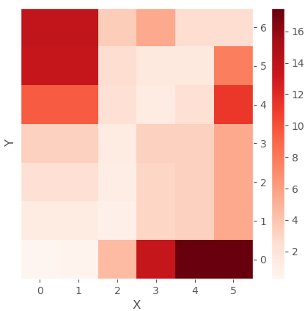
Dynamic Time Warping
2. Compute accumulated cost matrix
Can you see the warping / optimal path?
dists
acuCost
Notes:
wrapping path → along the lighted colour within the acuCost Matrix

Slide 28
Dynamic Time Warping
3. Search the optimal path
Name the warping path as path.
a list; j stands for x axis, i stands for y axis
> i = len(y)-1
> j = len(x)-1
> path = [[j,i]]
> while (i > 0) and (j > 0):
if i==0:
j = j-1
elif j==0:
i = i-1
else:
if acuCost[i-1,j] == min(acuCost[i-1,j-1],
acuCost[i-1,j],
acuCost[i,j-1]):
i = i-1
elif acuCost[i,j-1] == min(acuCost[i-1,j-1],
acuCost[i-1,j],
acuCost[i,j-1]):
j = j-1
else:
i = i-1
j = j-1
path.append([j,i])
> path.append([0,0])
Wrapping process: Compare 3 neighboring squares and find the minimum cost square
it starts from here
Notes:
optimal/wrapping path named as “path” is a list
show example of wrapping process! → compare 3 neighboring squares and find the minimum cost square!
Wrapping process represented by this set of code, which starts from top right, and determine all the minimum cost squares until it reaches D[0,0]

Slide 29
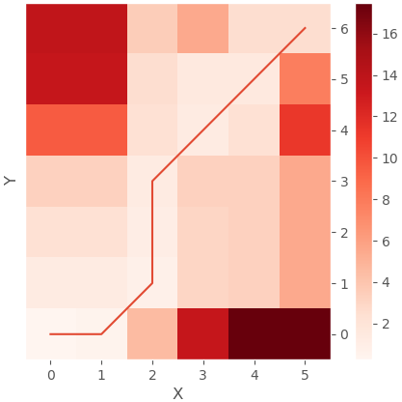
Dynamic Time Warping
3. Search the optimal path
Create a function that plots the path
> def pltCostAndPath(acuCost,path,xlab="X",ylab="Y",clrmap="viridis"):
px = [pt[0] for pt in path]
py = [pt[1] for pt in path]
imgplt = pltDistances(acuCost,
xlab=xlab,
ylab=ylab,
clrmap=clrmap)
plt.plot(px,py)
return imgplt
> pltCostAndPath(acuCost,path,clrmap='Reds')
Now we want to plot the path; this code function helps us draw the path
Notes:
previously, we have done path.append([ j, i ])
Now we want to plot the path → this code function helps us draw the path
Path is a list with 2 points: i and j; j stands for x axis, whereas i stands for y axis

Slide 30
Dynamic Time Warping
3. Search the optimal path
Calculate the cost based on dists, which can be considered as a measure for similarity / distance
This cost parameter is also known as the wrapping cost
> cost = 0
> for [j,i] in path:
cost = cost+dists[i,j]
> cost
: 2.5
acuCost
dists
Notes:
Codes to calculate the costs based on dists
Remember your accumulated cost is dependent on the distance →
Refer to previous formula → A[i,j] = D[i,j] + ……

Slide 31
Dynamic Time Warping
3. Search the optimal path
The implication
How to illustrate the mapping between the 2 signals (Right) based on the wrapping path in the Cost Matrix (Left)?
acuCost
Notes:
How to plot a line that shows the correspondence between point 5 in X and point 6 in Y?
Ans: plt.plot([5, 6], [X[5], Y[6]])

Slide 32
Dynamic Time Warping
3. Search the optimal path
The implication
How to plot a line that shows the correspondence between point 5 in X and point 6 in Y?
Ans: plt.plot([5, 6], [X[5], Y[6]])
acuCost
Notes:
How to plot a line that shows the correspondence between point 5 in X and point 6 in Y?
Ans: plt.plot([5, 6], [X[5], Y[6]])

Slide 33
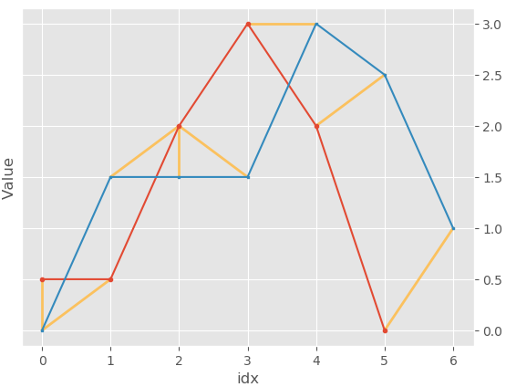
Dynamic Time Warping
3. Search the optimal path
Plot the mapping of points between two signals
> def pltWarp(s1,s2,path,xlab="idx",ylab="Value"):
imgplt = plt.figure()
for [idx1,idx2] in path:
plt.plot([idx1,idx2],[s1[idx1],s2[idx2]],
color="C4",
linewidth=2)
plt.plot(s1,
'o-',
color="C0",
markersize=3)
plt.plot(s2,
's-',
color="C1",
markersize=2)
plt.xlabel(xlab)
plt.ylabel(ylab)
return imgplt
> pltWarp(x,y,path)
idx1 and idx2 are the interested time parameters
Plot the connections between s1 and s2 (yellow lines)
Notes:
function to plot how each point corresponds to one another!
s1 and s2 are the 2 different signals; idx1 and idx2 are the interested time parameters
show how through examples → which point/line matches with which point/line
Illustrates how signals of different shapes and sizes can be related to each other using DTW method

Slide 34
Dynamic Time Warping
Notes:
Compare original chart and chart with DTW

Slide 35
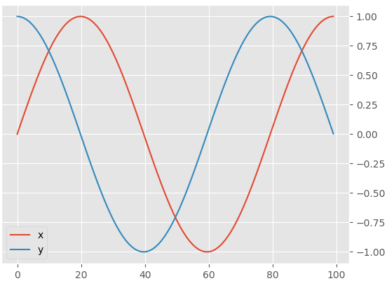
Dynamic Time Warping
Another example
Define two signals as:
> x = np.sin(np.linspace(0,7.85,100))
> y = np.cos(np.linspace(0,7.85,100))
Another example with 2 different signals
Plot the two signals
> plt.figure()
> plt.plot(x,
color="C0",
label='x')
> plt.plot(y,
color="C1",
label='y')
> plt.legend()
Notes:
Another example with different signals

Slide 36
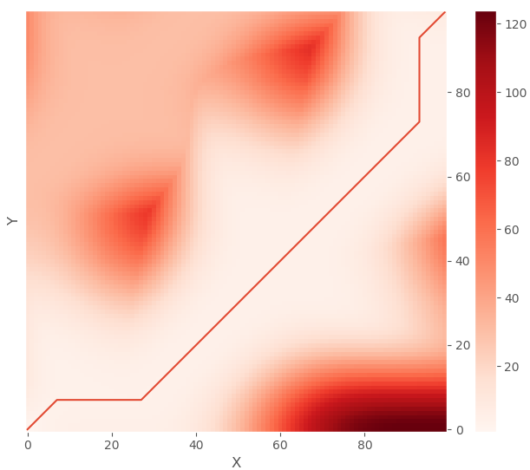
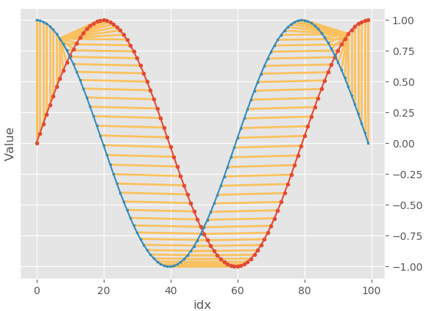
Dynamic Time Warping
Another example
Notes:
Wrapping results for the new set of signals
matrix here in this example is better if you want to utilize machine learning

Slide 37
Back to the problem
How to start?
Before we compute similarity, must segment individual heartbeat signal
With signal segmented, perform DTW
Use peak (i.e. findpeak) to estimate start of each ECG heartbeat by shifting 15 points to left from peak
15 points
15 points
Notes:
back to ECG signals problem → from peak (use findpeak learnt from Workshop 1), shift 15 points to left = start of ECG heartbeat

Slide 38
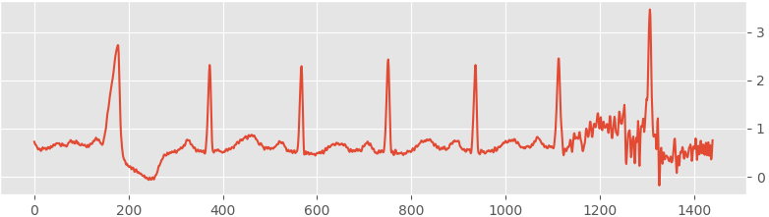
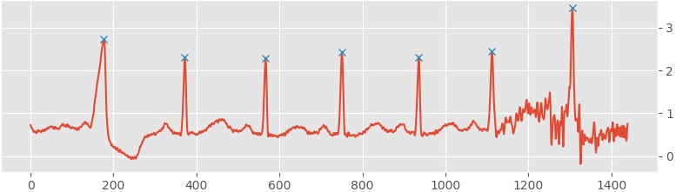
Workshop
To start
Load the data
> l2D = pd.read_csv('ecg2D.csv',
header=None)
> ECGs = l2D[1].values
You need to complete a code function to chop (segment) each ECG heartbeat from the complete signal!
Create a function with the below signature. The output is a list consists of all the ECG segments in a ECG signal
def extractECG(ecg,pks,offset=15):
General Procedures:
Load data
Perform peak detection
Extract segments based on the detected peaks
Notes:
Code function that you need to complete to help chop (segment) each ECG heartbeat!
Load data, then Perform peak detection
Then Extract segments based on the detected peaks

Slide 39
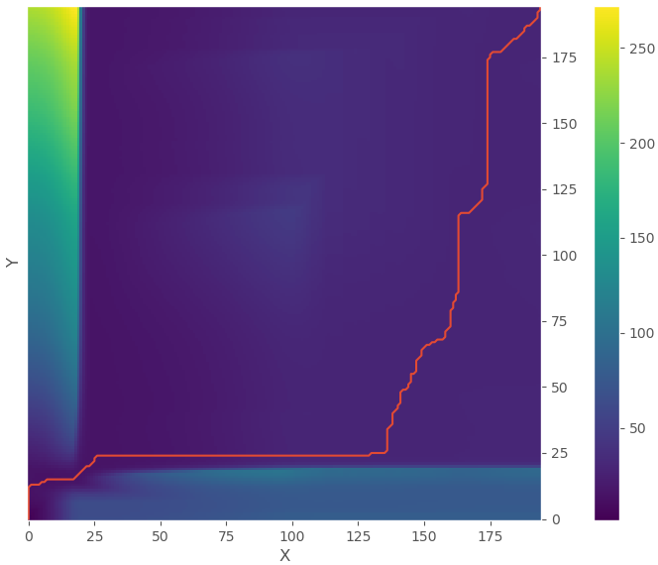
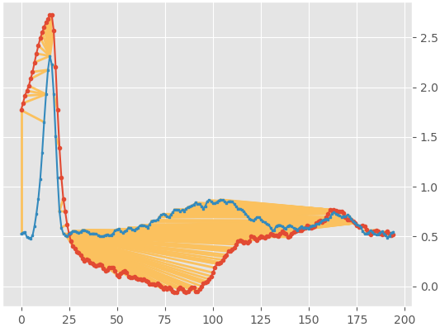
Workshop
Compute the accumulated costs, plot the optimal paths and warp
Make the comparisons between segment
    1 and 2
    2 and 3
    2 and 6
If you are done early, try on other signals
(i.e. other than the 2nd column of the ecg2D data)
Notes:
Go to google documents and colab to demonstrate

Slide 40
Workshop Hints for extractECG function
Tips how to chop the ecg:
Assume, you have all the peaks being identified, and ‘pks’ is the list to hold all the position of peaks. Assume ‘ecg’ is the ECG signals. Then you need to go through a “for-loop”, for each iteration, you do:
Seg = ecg[(pks[i]-offset):(pks[i+1]-offset)]
Another Tip: You need to ignore the last peak
Notes:
Go to google documents and colab to demonstrate

Slide 41
Workshop Hints for extractECG function
Tips how to chop the ecg:
def extractECG(ecg,pks,offset=15):
segs = [ ]
if pks[0]-offset < 0:
start = 1
else:
start = 0
for i in range(start,len(pks)-1):
seg = ecg[(pks[i]-offset):(pks[i+1]-offset)]
segs.append(seg)
return segs
EcgSegs = extractECG(ECGs,Pks)
Notes:
Go to google documents and colab to demonstrate

Slide 42
Workshop Hints for Performing DTW on ECG segments
Example for comparing between segments 1 and 2:
dist = computeDists(segs[0],segs[1])
acuCost = computeAcuCost(dist)
(path,cost) = doDTW(segs[0], segs[1], dist, acuCost)
pltCostAndPath(acuCost, path)
pltWarp (segs[0], segs[1], path)
Notes:
Go to google documents and colab to demonstrate

Slide 43
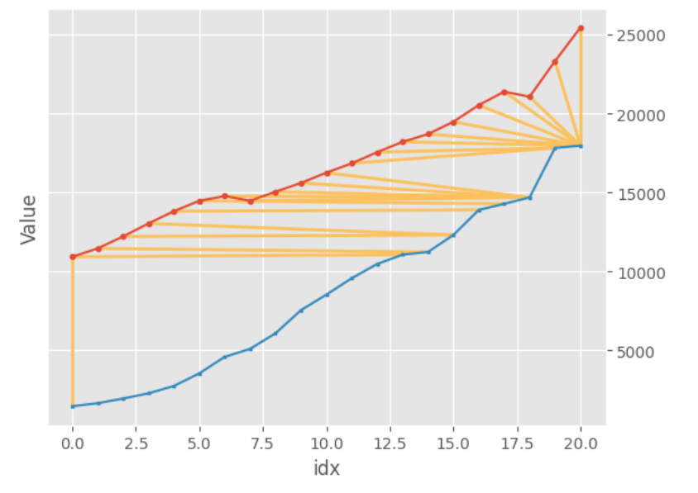
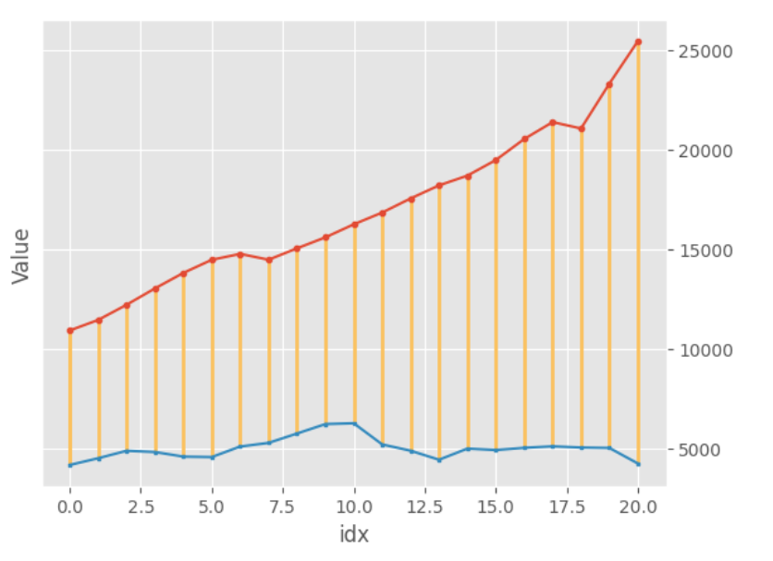
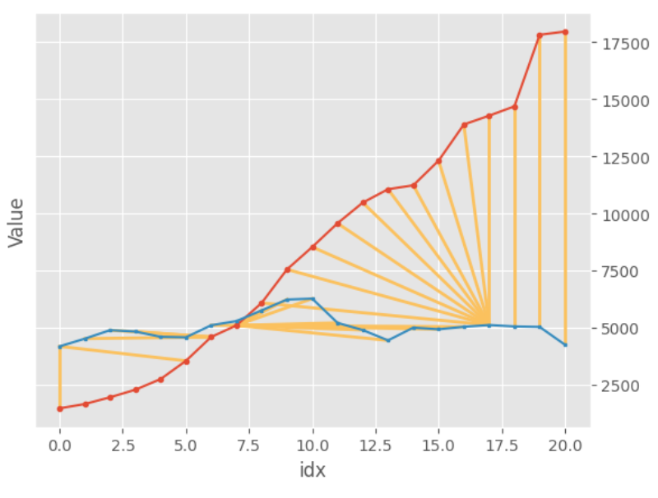
Bonus Workshop [Do NOT need to submit this]
Comparing U.S., China & Japan GDP for the past 2 decades [2002 to 2022]
Using the GDP.csv data, use DTW to compare the following:
U.S GDP vs China GDP
China GDP vs Japan GDP
U.S GDP vs Japan GDP
The breakdown of the GDP.csv data file is as follows:
Column 1 – U.S GDP
Column 2 – China GDP
Column 3 – Japan GDP
Notes:
Go to google documents and colab to demonstrate

Slide 44
Appendix: Comparison among Various Methods
To measure similarity between signals
 | Pros | Cons
Euclidean/Manhattan distance | Easy to implement; straightforward | Only works if the signals to be compared are of same length and preferably similar shape
DTW | Not necessary for signals to be of same length and shape; Computes faster than LCSS | Heavy computational burden (worse than Euclidean/Manhattan distance method); Unable to work if one of the signals is a partial type
Subsequence DTW (SS-DTW) | Can handle partial signals; Aligns a subsequence from one signal with another | Still computationally expensive compared to Euclidean/Manhattan; May still struggle with noisy signals
Longest common subsequence (LCSS) | Not necessary for signals to be of same length and shape; Allows for the use of partial and noisy signals | Heavy computational burden; Computes slower than DTW
Developed Longest Common Subsequence (DLCSS) | Not necessary for signals to be of same length and shape; Allows for the use of partial and noisy signals; Most accurate among the other methods | Heavy computational burden; Computes slower than DTW and LCSS

